Slide 1
Experiences: War
Waltz with Bashir

Slide 2

Lebanon
Lebanon, country located on the eastern shore of the Mediterranean Sea. It consists of a narrow strip of territory and is one of the world’s smaller sovereign states. The capital is Beirut
Lebanon shares many of the cultural characteristics of the Arab world
Identifying all Lebanese as ethnically Arab is a widely employed example of panethnicity since in reality, the Lebanese "are descended from many different peoples who are either indigenous, or have occupied, invaded, or settled this corner of the world", making Lebanon, "a mosaic of closely interrelated cultures"
Notes:
The diversity of the Lebanese population played a notable role in the lead-up to and during the conflict: Sunni Muslims and Christians comprised the majority in the coastal cities
the country's parliamentary structure favoured a leading position for its Christian-majority population. However, the country had a large Muslim population to match, and many pan-Arabist and left-wing groups opposed the Christian-dominated pro-Western government. The influx of thousands of Palestinians in 1948 and 1967 contributed to the shift of Lebanon's demography in favour of the Muslim population.

Slide 3
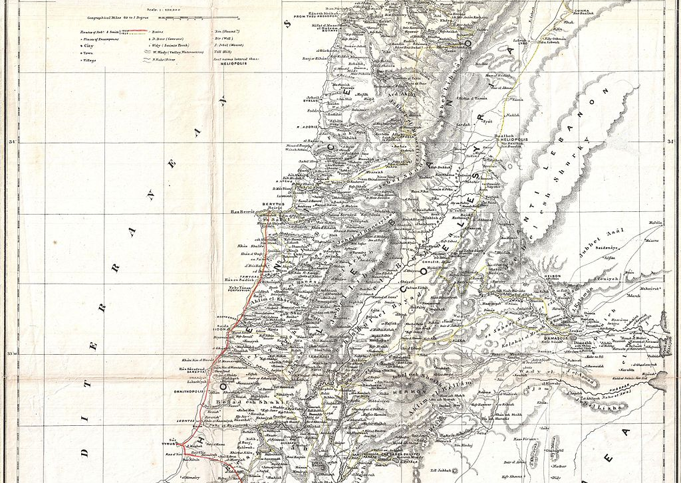
Civil War
1975-1990
Fighting between Maronite-Christian and Palestinian forces (mainly from the Palestine Liberation Organization) began in 1975; leftist, Muslim, and pan-Arabist Lebanese groups formed an alliance with the Palestinians in Lebanon.

Slide 4

Israel, officially the State of Israel, is a country in West Asia. It is boarded by Lebanon to the north
Israel's diverse culture stems from the diversity of its population. Jews from diaspora communities around the world brought their cultural and religious traditions back with them, creating a melting pot of Jewish customs and beliefs. Arab influences are present in many cultural spheres as well. (dominated by Hebrew culture but strongly influenced by Arabic culture too)
Israel

Slide 5
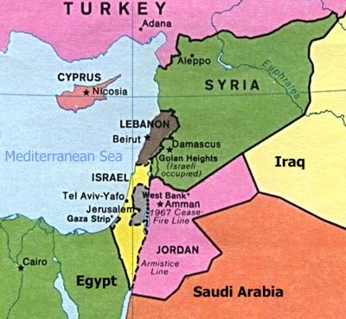

Slide 6

Israeli–Palestinian conflict
Jew versus Islamic
Two-state policy

Slide 7
1982. 9.14 4:10pm Beirut, the Capital of Lebanon
An important meeting held in The Lebanese Kataeb Party. A pre-placed bomb killed the young president Bashir Gemayel
Israeli army invade Lebanon shortly after this incident. They have been looking for opportunities to slaughter the Palestinians in a refugee camp in Beirut. The excuse is that about 2,000 people were left after the Palestine Liberation Organization withdrew from Beirut in August. In order to “restore and maintain order in Beirut” they want to “search for the remaining Palestinian guerrillas.”
When Bashir is murdered, no one can stop them from doing so. However, Israelis are afraid of suffering from world public opinion, they decided to appear as little as possible in the massacre.
1982. 9.15 2:00 am, The Isaraeli army quickly entered two Palestinian refuge camps in West Beirut, Shatila and Sabra. At that time thousands of Palestinian civilians were sleeping soundly, and these people didn’t expect it.
Around 6 am, the Israeli army let a team of right-wing extremists in from south , and the massacre has began.
Meanwhile Israel provide the extremists with artillery support

Slide 8
The Israeli Supreme Court ruled that, taking into account the government’s opinion, the court did not agree to declassify the investigation report of the 1982 massacre in Lebanon

Slide 9
Reading 1
What’s movie about according to the writer?
What’s the significance of showing Boaz’s dream about dogs?
How does the use of animation help to demonstrate soldiers’ trauma in the war?
What does the blue woman symbolizing?
Why would the soldier imagine her according to the writer?
What’s another way soldiers adopted to deal with the horror of war according to the movie?
What effect animation has on the audience?

Slide 10
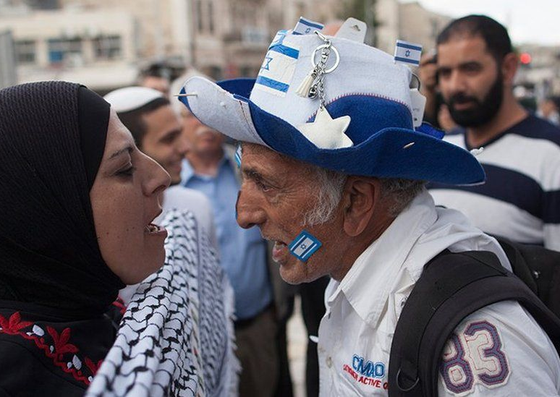
What’s new
The Palestinian militant group Hamas (the Islamic Resistance Movement) launched an unprecedented assault on Israel, with hundreds of gunmen infiltrating communities near the Gaza Strip.

Slide 11
What happened next
Sanction

Slide 12
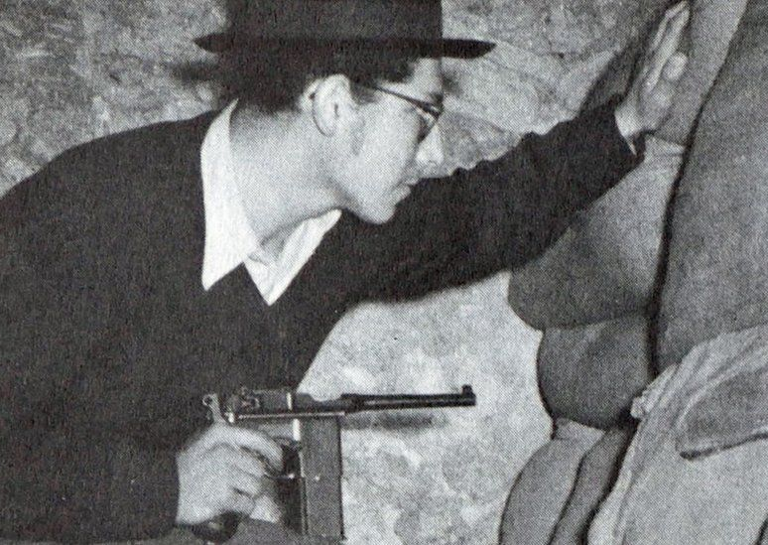
Britain took control of the area known as Palestine after the ruler of that part of the Middle East, the Ottoman Empire, was defeated in World War One.
The land was inhabited by a Jewish minority and Arab majority, as well as other, smaller ethnic groups.
Tensions between the two peoples grew when the international community gave the UK the task of establishing a "national home" in Palestine for Jewish people.
To Jews Palestine was their ancestral home, but Palestinian Arabs also claimed the land and opposed the move.

Slide 13
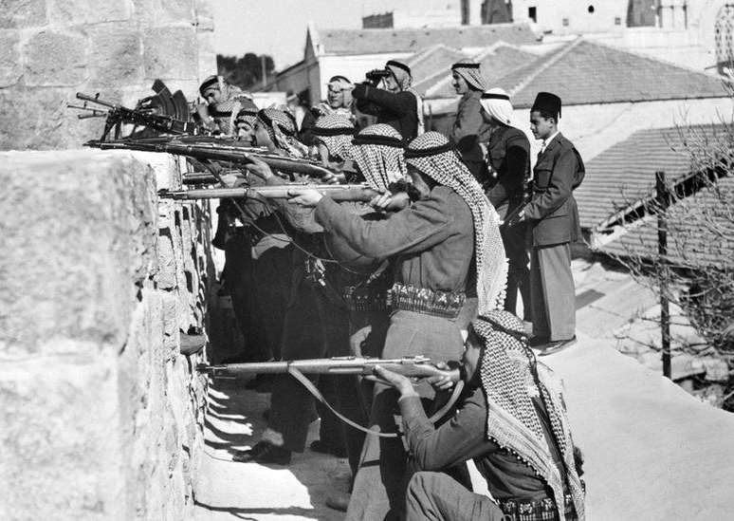
Between the 1920s and 1940s, the number of Jews arriving there grew, with many fleeing from persecution in Europe, especially the Nazi Holocaust in World War Two.
Violence between Jews and Arabs, and against British rule, also increased.
In 1947, the UN voted for Palestine to be split into separate Jewish and Arab states, with Jerusalem becoming an international city.
That plan was accepted by Jewish leaders but rejected by the Arab side and never implemented.

Slide 14
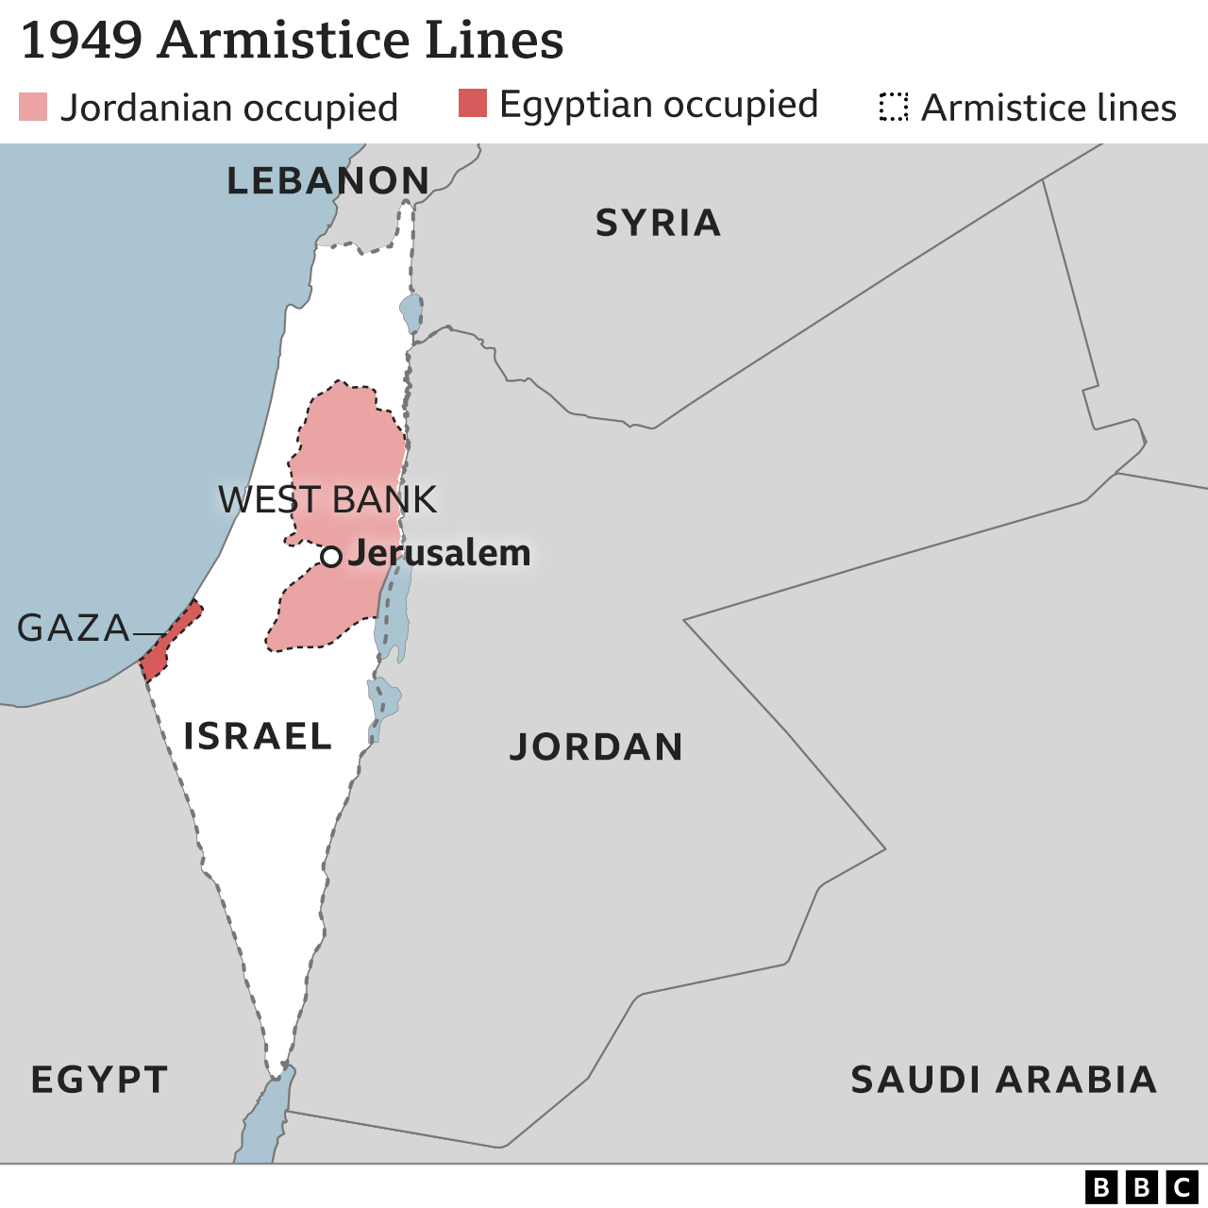
Israel Palestine conflicts
In 1948, unable to solve the problem, Britain withdrew and Jewish leaders declared the creation of the State of Israel.
It was intended to serve as a safe heaven for Jews fleeing persecution, as well as a national homeland for Jews.
Fighting between Jewish and Arab militias had been intensifying for months, and the day after Israel declared statehood, five Arab countries attacked.

Slide 15
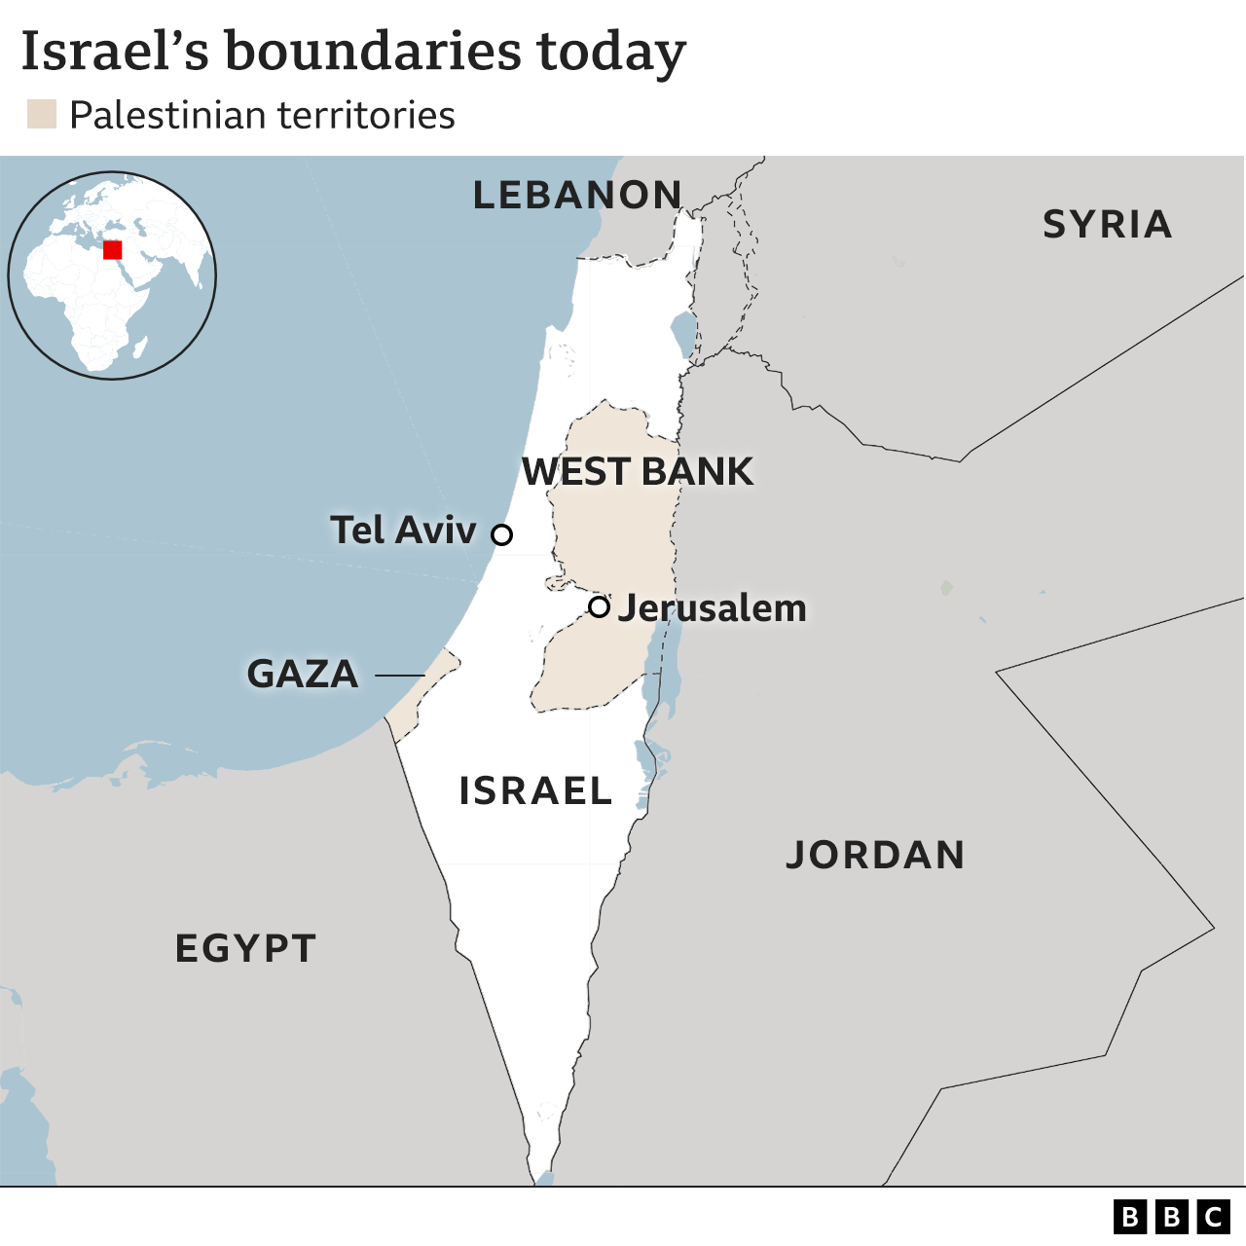
Israel Palestine conflicts
Hundreds of thousands of Palestinians fled or were forced out of their homes
By the time the fighting ended in a ceasefire the following year, Israel controlled most of the territory.
Jordan occupied land which became known as the West Bank, and Egypt occupied Gaza.
Jerusalem was divided between Israeli forces in the West, and Jordanian forces in the East.
Because there was never a peace agreement there were more wars and fighting in the following decades.

Slide 16
Refugees
Do countries have a moral obligation to take refugees? What about children?
Do countries have a moral obligation to take refugees fleeing from their country due to destruction caused by climate change?

Slide 17
What challenges may refugees face?
Application for an asylum could be rejected, then they will be deported. What would happen to them then?
They may wait in refugee camps for weeks/months/years
They may be put in prison being misjudged as illegal immigrates

